Slide 1
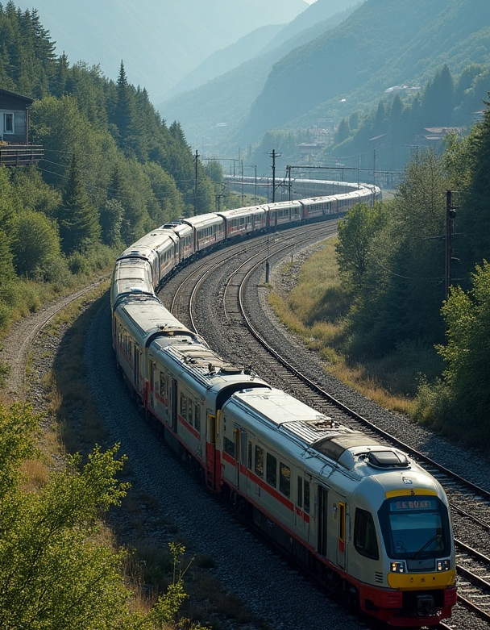
Railway Network Optimization

Slide 2

Project Title & Objective
Title: Railway Network Optimization System
Objective:
Model and optimize railway systems using graph theory.
Visualize shortest paths, key stations, and infrastructure-efficient routes.
Provide a user-friendly GUI for simulation and decision support.

Slide 3
Updated Workflow / Architecture
Architecture Overview:
Frontend: Tkinter GUI
Backend: NetworkX for algorithms
Visualization: Matplotlib embedded using FigureCanvasTkAgg
Storage: GPickle for save/load
Design: Modular, event-driven application with persistent graph state

Slide 4

Technical Progress
Completed Modules: ✅ Dynamic station input & distance matrix ✅ Dijkstra’s Algorithm for shortest path ✅ MST for infrastructure optimization ✅ Centrality (degree, betweenness) for key nodes ✅ Import/Export network via .gpickle ✅ Graph visualizations with edge weights

Slide 5
Technical Challenges & Solutions
Matrix Input GUI: Solved using a dynamic dictionary of widgets
Matplotlib Freezing UI: Embedded using FigureCanvasTkAgg
Directed to Undirected Conversion: Required for MST
Input Validation: Handled using try-except and alerts
Pending: Max Flow algorithm integration

Slide 6
UI Interface & Functionality
Main Menu Options:
Create New Network
Find Shortest Path
Show Minimum Spanning Tree
Show Centrality
Import/Export
Exit

Slide 7

GUI Highlights
Matrix input interface
Shortest path visualized with highlighted routes
MST and centrality analysis with node coloring (Insert 2-3 annotated screenshots from the GUI here)

Slide 8
Minimum Spanning Tree (MST) Application
The Minimum Spanning Tree (MST) application in the system identifies the least costly way to connect all stations in the network without creating cycles. By utilizing MST algorithms, operators can optimize infrastructure costs while ensuring connectivity across all stations. This is crucial for strategic planning and resource allocation, minimizing redundancy and maximizing efficiency.

